Slide 1
Extra-Ordinary Meeting
22 June 2026

Slide 2
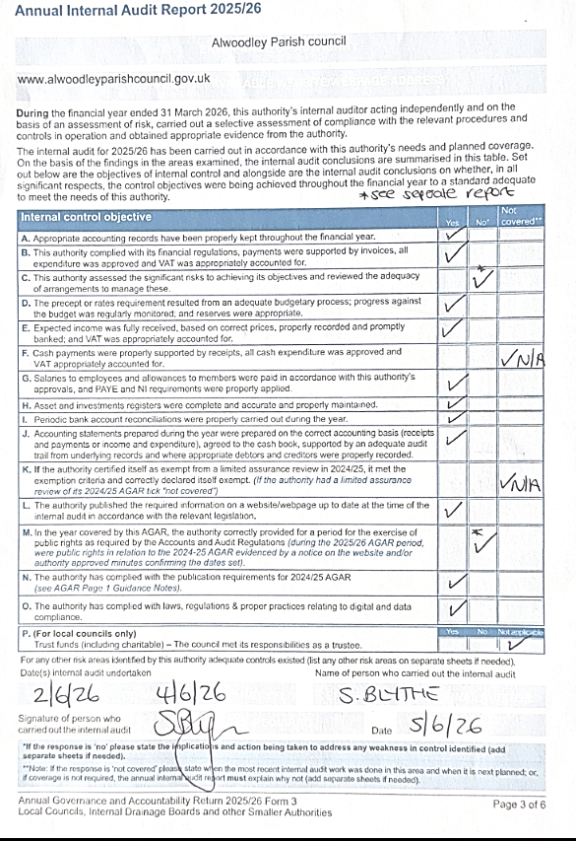
2627/65
To receive and note the Annual Internal Auditor’s Report for the 2025/26 financial year. (This is the required report form, signed by the auditor)

Slide 3
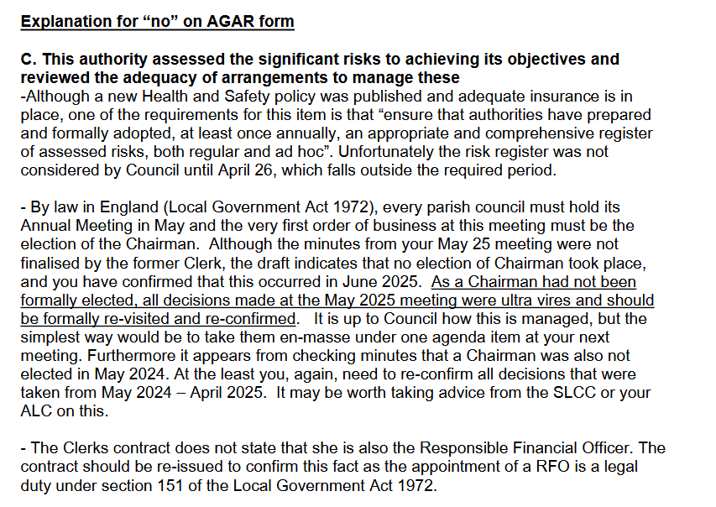

Slide 4
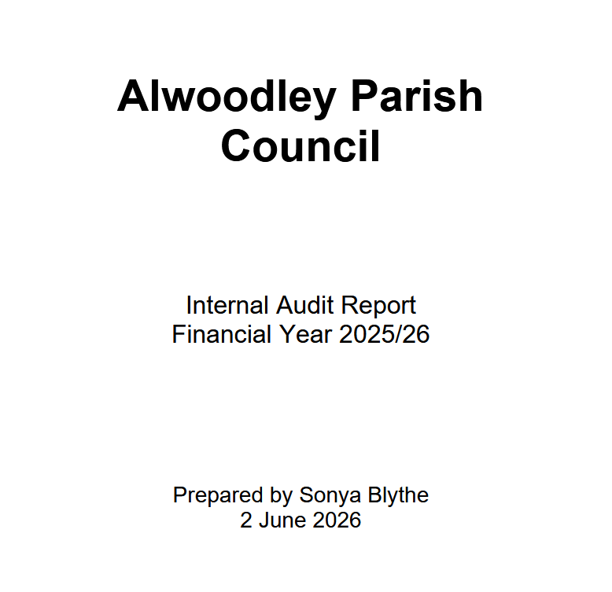
2627/65
To receive and note the Annual Internal Auditor’s Report for the 2025/26 financial year. (This is the extended version of the required report with explanations and recommendations)

Slide 5
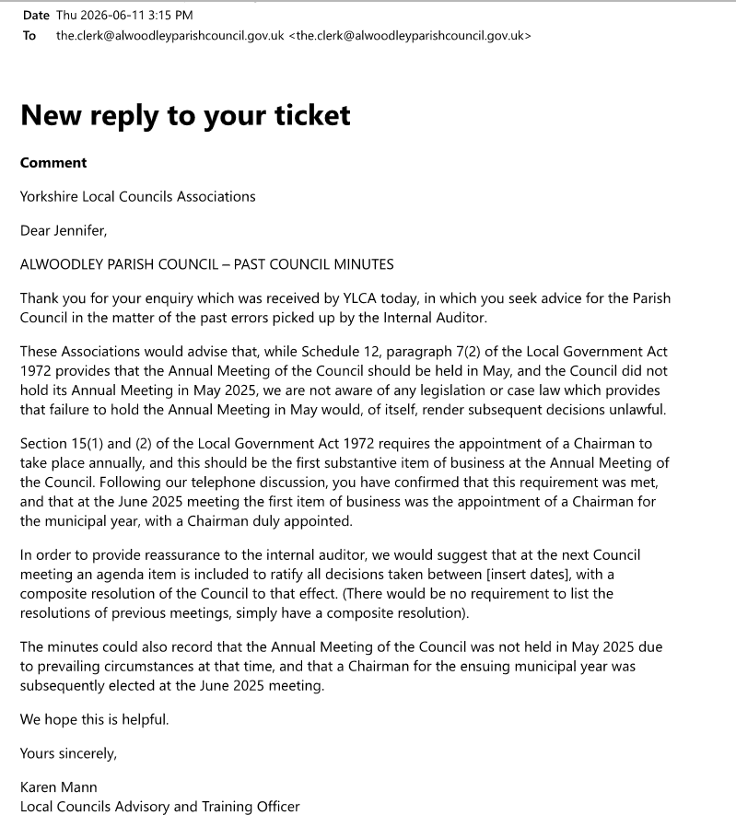

Slide 6
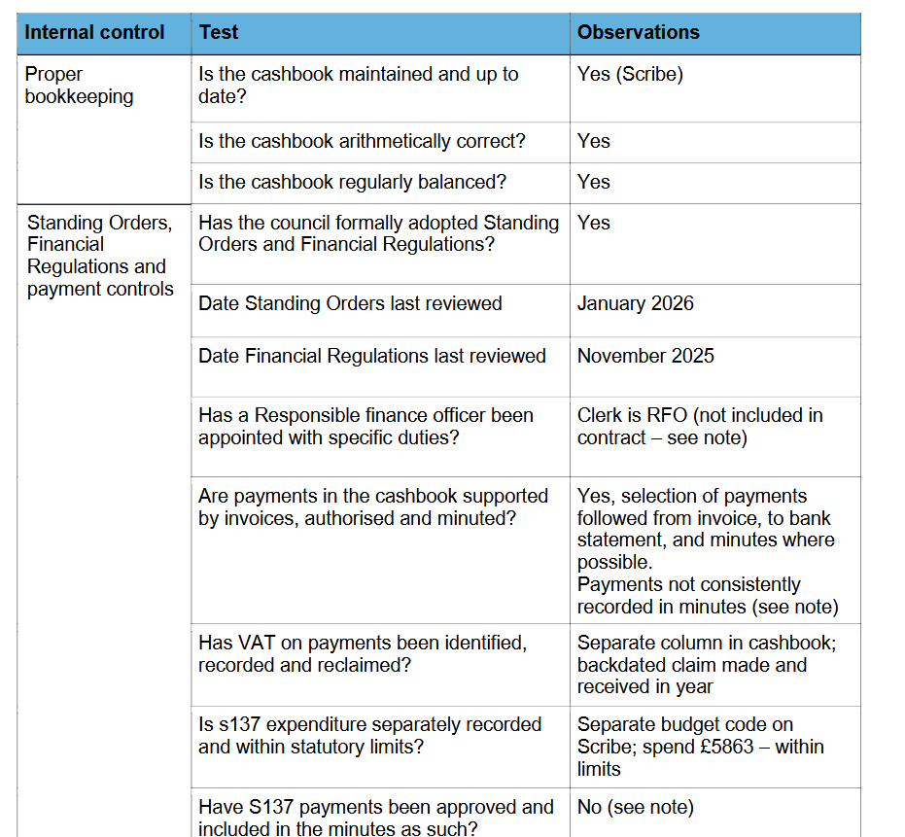
Actions:
1. Add RFO title/role to clerk contract
2. Continue improved oversite of payments
3. Minute S137 payments clearly

Slide 7
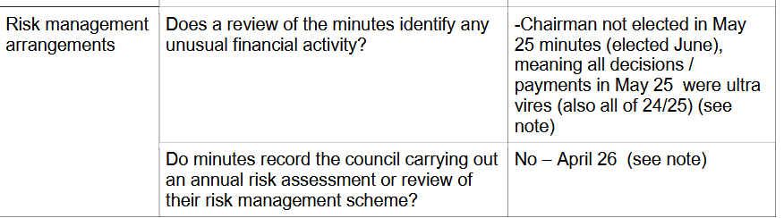
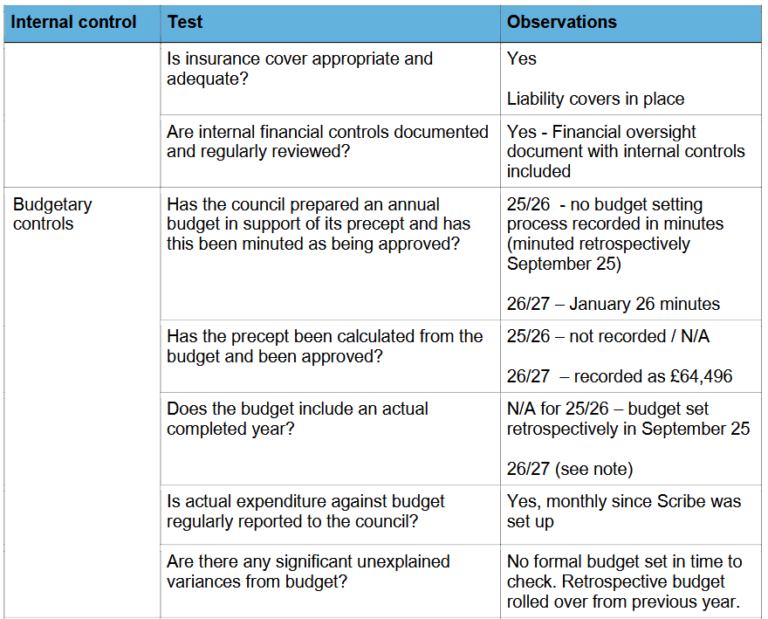
Gaps in required procedures in Apil – June 2025, when there was a gap in Clerk, Council didn’t
1) elect a Chair in May
2) set and pass a budget or formally
3) set and minute the precept.
Auditor noted internal controls in place in 2026/2027 to signal that the Council has now remedied these.

Slide 8
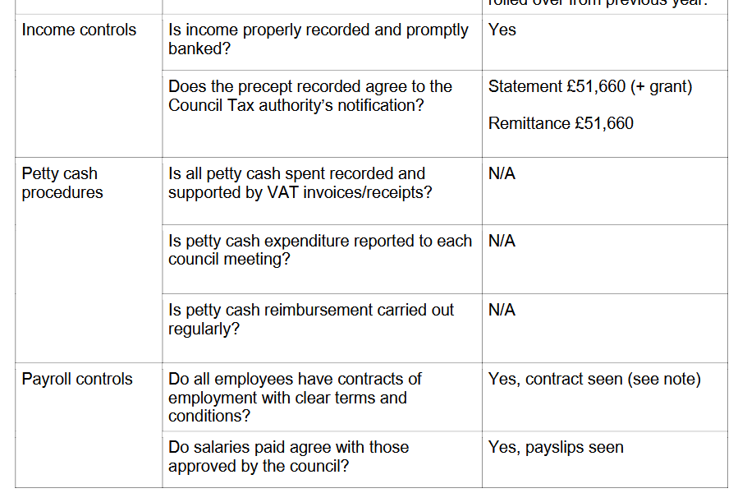
These sections clear of comments

Slide 9
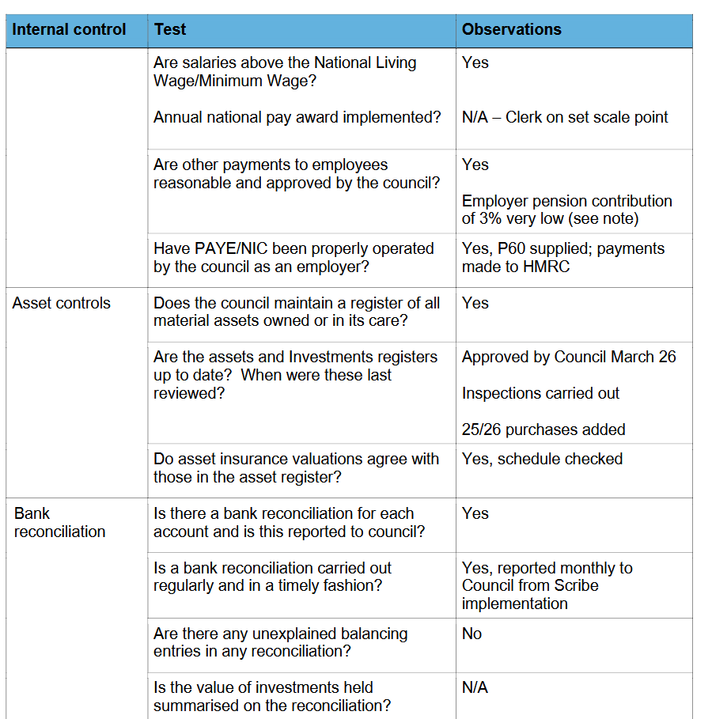
These sections are clear, except note about low pension contribution to Clerk.

Slide 10
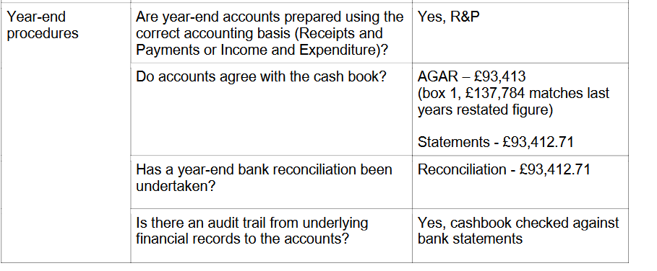
Year-End Procedure Correct

Slide 11
Have points raised on the last (24/25) Internal Audit report been considered by council and actioned?
23/24 points:
• Cashbook not being maintained throughout the year
-Yes, full accounts now on Scribe
• Meeting minutes not being available to the public after September 2022
-Minutes uploaded to website after meetings
• Payments were not supported by invoices authorized and minuted
-Yes, selection followed through complete process, once new Clerk took over
• VAT not being claimed during the year
-Backdated VAT claimed
• No evidence of risk assessment
-Not completed within 25/26* (from Jen: auditor noted that this was completed in April 2026, but not within timeframe)
• No evidence of internal financial controls
-Financial oversight document in place
No training policy or budget for staff or Councillors
-Training budget included in 26/27budget
• No HR policies
-Now in place
• No Health and Safety Policies
-Now in place
• Asset register not reviewed
and updated
-Reviewed and minuted March 26
• Registration with Information Commissioner expired
November 2023
-Membership renewed November 25
• Policies on website not updated and current and require
review for effectiveness
-Majority of policies now reviewed
24/25
Internal Control objectives A, B, C, D, E, G, H, I, J, L and M not
signed
– covered in written report below

Slide 12
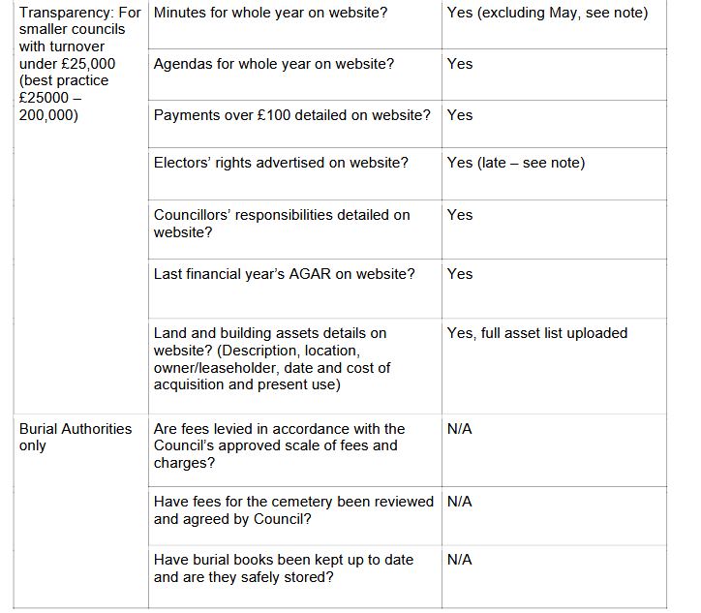
Elector’s rights were not advertised on time due to last year’s delayed audit.
Otherwise clear.

Slide 13
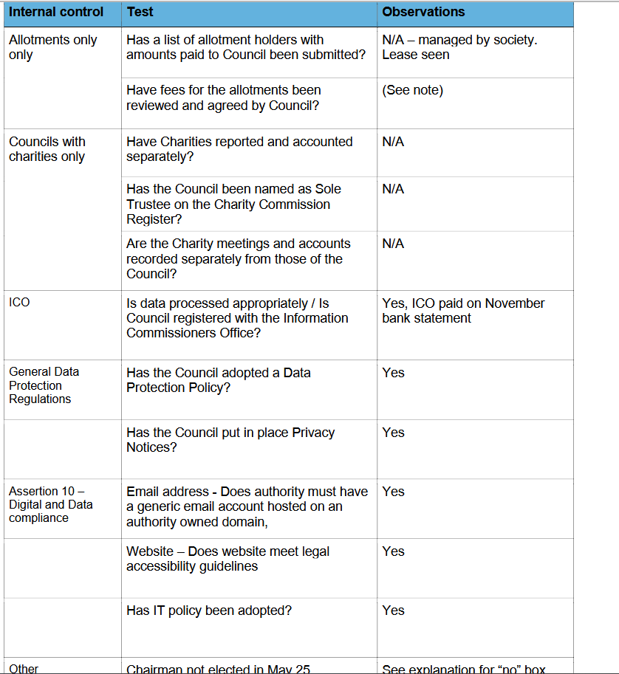
These sections clear. Some implications as Chair not elected in May.

Slide 14
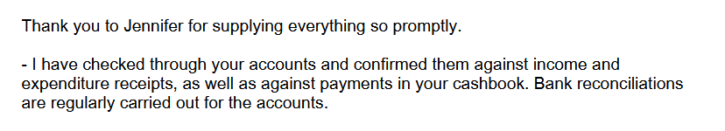
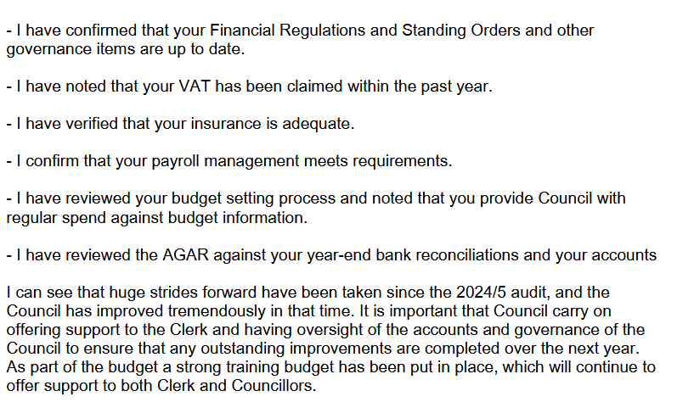

Slide 15
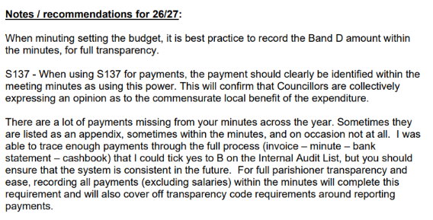

Slide 16
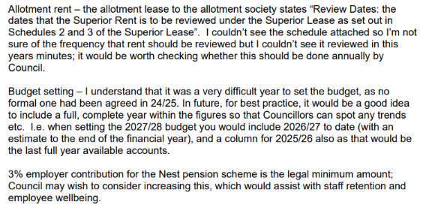

Slide 17
Recommended Resolutions
Noted that the the report of the Internal Auditor has been Received.
Resolved to implement action plan to address internal auditor’s recommendations including:
Record all S137 payments in minutes
Amend Clerk contract to include RFO title and specific duties.
Consider increase to pension contribution in next budget
Fully implement improved internal control process that has been put in place
Formalise date setting and invoicing procedure for the Allotments so that it is more transparent.
Include previous year’s budget figures in next year’s budget for transparency
Include Band D payment amount in minutes when setting the budget

Slide 18
2627/66
a) To note internal auditor’s comments enquiring about the standings of decisions taken from May 2024 – May 2026 because Council failed to properly elect and minute election of Chair at May Annual Meetings in 2024 and 2025
b) To note advice from YLCA that decisions are still lawful.
c) To note that the Annual Meeting of the Council was not held in May 2025 due to prevailing circumstances at that time, and that a Chairman for the ensuing municipal year was subsequently elected at the June 2025 meeting.
d) To ratify all decisions taken from May 2024 through May 2025 via a composite resolution for good practice and to satisfy comments from the internal auditor.

Slide 19
2627/67 Annual Governance Statement (AGAR Section 1)
To consider, approve, and authorize the Chairman and Clerk to sign Section 1 (Annual Governance Statement) of the Annual Governance and Accountability Return for the 2025/26 financial year.

Slide 20
Approval Process for the Annual Governance Statement
2627/67 Annual Governance Statement (AGAR Section 1)
To consider, approve, and authorize the Chairman and Clerk to sign Section 1 (Annual Governance Statement) of the Annual Governance and Accountability Return for the 2025/26 financial year.
Review Internal Audit: Before considering Section 1, the council must receive, review, and formally note the Annual Internal Audit Report. The Council can resolve also to take action on specific recommendations in the report.
Consider the Assertions: The council must collectively review the nine governance assertions listed in Section 1 and confirm agreement with a "Yes" answer for each.
If any statement is answered "No", the council must attach an explanation detailing the control weaknesses and how they are being addressed.
Note:
Vote and Approve: The council must pass a resolution formally approving Section and authorising the Chairman and Clerk to sign the Annual Governance Statement of the AGAR for 2025/2026. .
This must happen before they move on to approve Section 2.
Sign and Date: Following the vote, the Chair and the Clerk of the meeting must sign and date Section 1.
Record in Minutes: The exact approval must be recorded in the council's formal minutes, noting the date of the meeting and the specific minute reference.

Slide 21
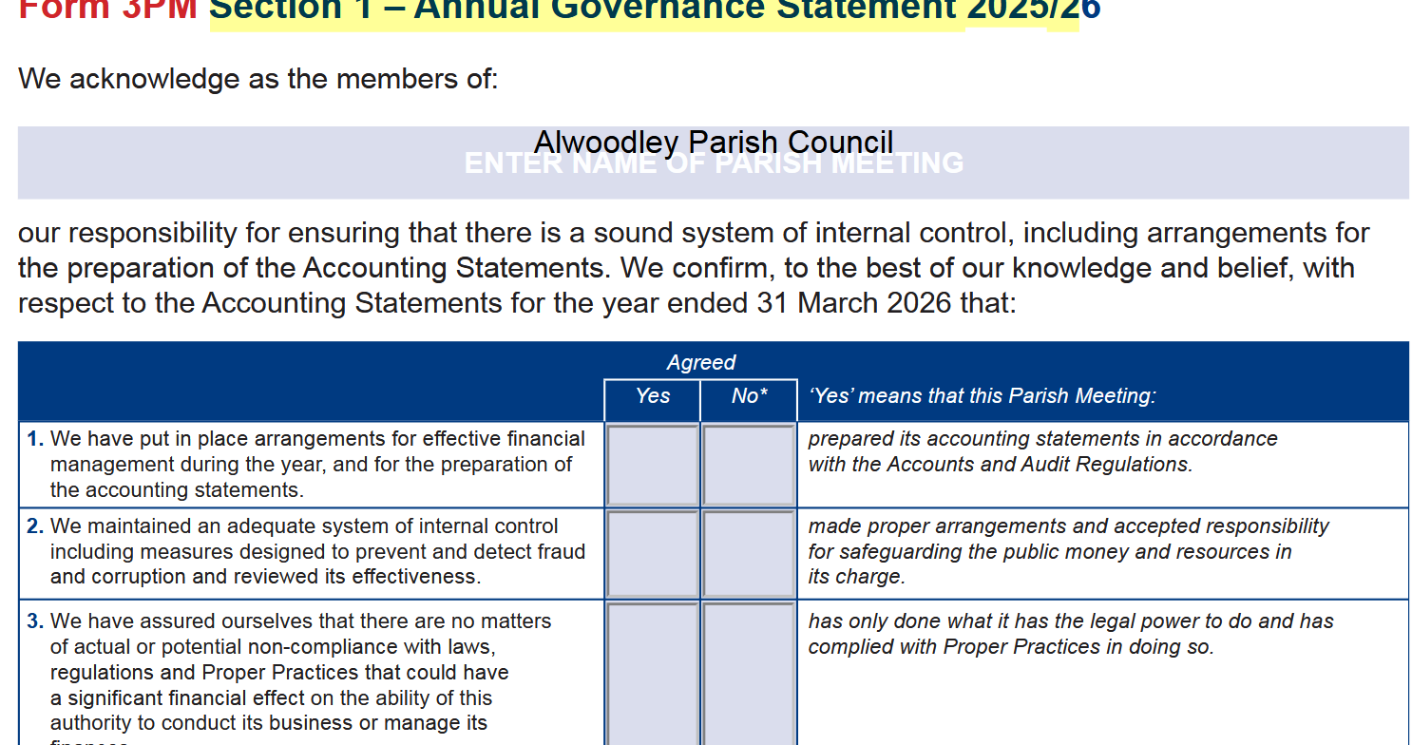

Slide 22
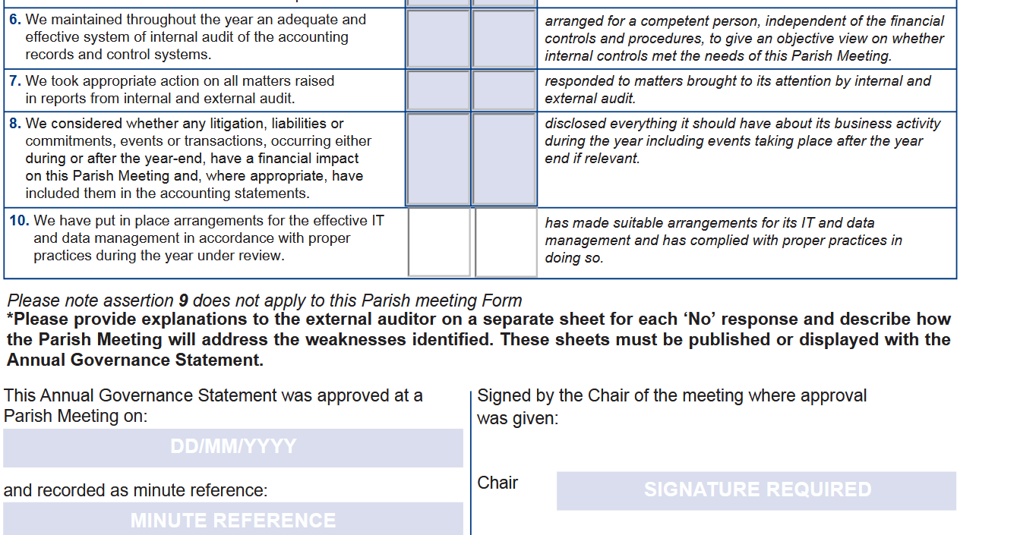

Slide 23
2627/68 Accounting Statements (AGAR Section 2)
To consider, approve, and authorize the Chairman to sign Section 2 (Accounting Statements) of the Annual Governance and Accountability Return and supporting bank reconciliation and explanation of variances for the 2025/26 financial year.

Slide 24
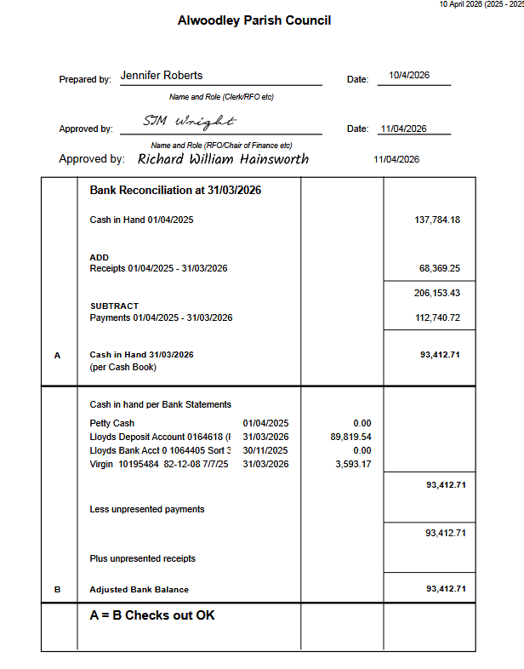
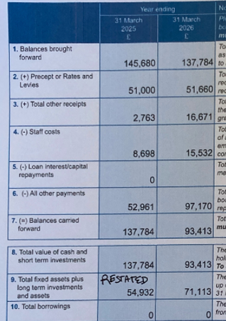
Comparing Accounting Statement to Bank Reconciliation

Slide 25
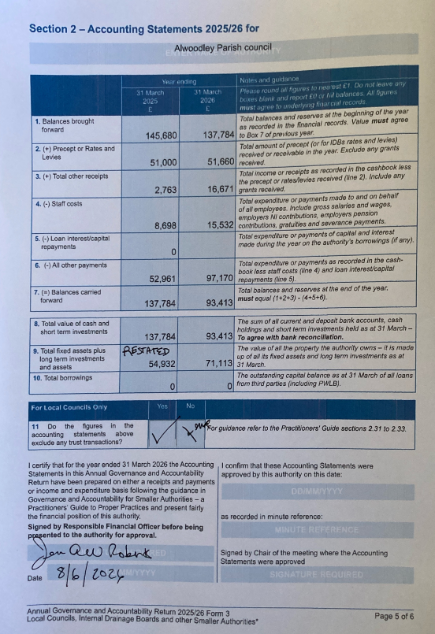
Accounting Statement
3. The increase in receipts is primarily due to a large VAT refund received from HMRC during the 2025/2026 financial year, £6,669.72, as the Council had not claimed back VAT since 2022.
4. Staff costs increased due to changes in the Clerk's working hours from a standard of 20 hours per month to 50 hours per month, plus additional hours for cleaning up gaps due to gap caused by not having a clerk in post for some time. Increase salary rate
6. The increase in general expenditure is due to several large, one-off project payments and delayed invoices being settled in the 25/26 financial year, heavily featuring payments to Leeds City Council. This included a newly laid footpath for £10K, a playground installation for £30K along with thousands of pounds of payments to Leeds City Council for festive lights from previous years.
9. Several items were missing on the register before I updated it. SLCC and internal auditor advised me to write “RESTATED” box 9 and to let the eternal auditor know that last year’s figure was incorrect, and, if it were correct, there wouldn’t be such a big variance.
11. it’s a yes to say yes, there are no trust fund figures included within the accounts.

Slide 26
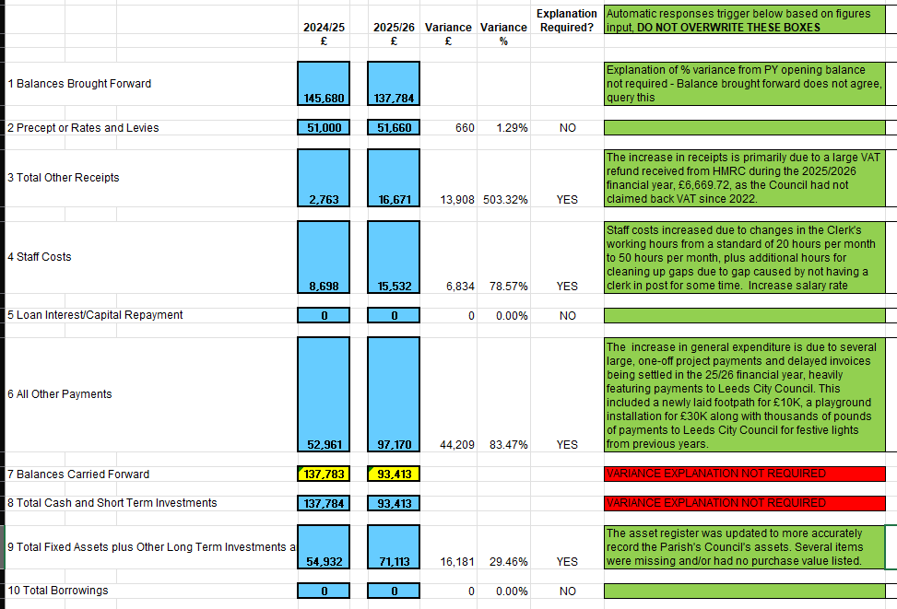
Explanation of Variances

Slide 27
2627/69 Publication of Audit Documents & Public Rights
To note the dates set by the Responsible Financial Officer (RFO) for the Period for the Exercise of Public Rights, from Wednesday 24th June 2026 to Tuesday 4th August 2026, and to approve the publication of all statutory documents required under the Accounts and Audit Regulations 2015, including:
The Annual Internal Audit Report 2025/26
AGAR Section 1 – The Annual Governance Statement 2025/26
AGAR Section 2 – The Accounting Statements 2025/26
The Explanation of Variances
The Bank Reconciliation (as of 31 March 2026)
The Notice of the Period for the Exercise of Public Rights

Slide 28
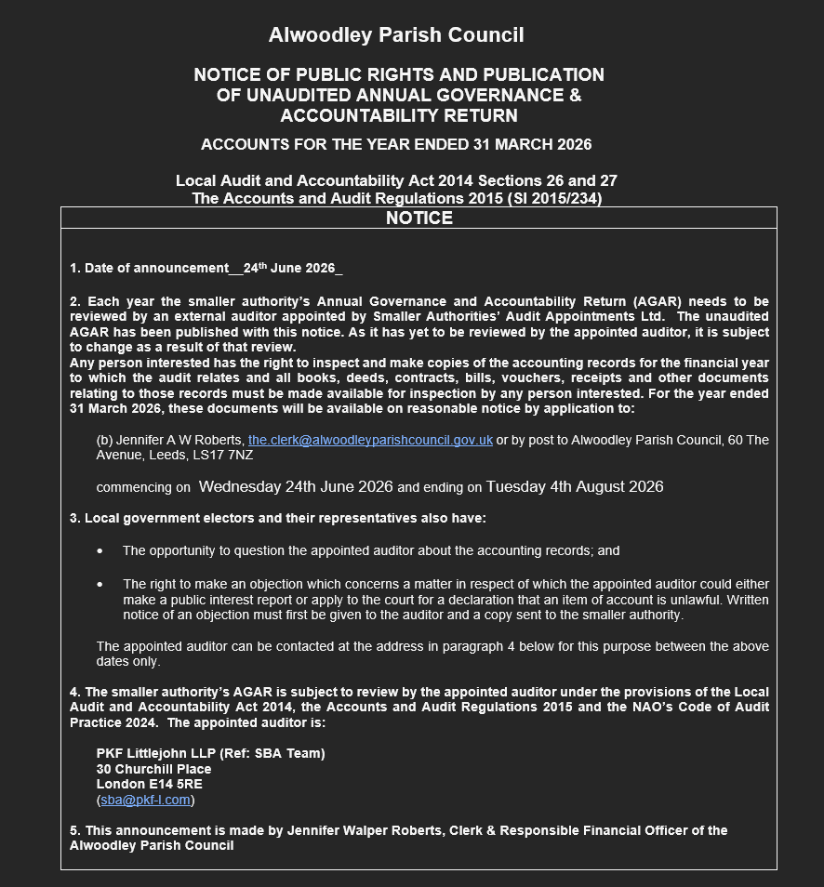
Requirements for Notice of Public Rights and Publication…
Exactly 30 working days
Includes the first 10 working days of
Dates I’ve set – 24th June – 4th August include 30 working days and include the first 10 working days of July. (Please check before you approve this!)

